Slide 1

DATA DRIVEN
POPULARITY OF THEME PARKS
DATA SCIENCE:
THE POPULARITY OF THEME PARKS
AND THEIR ATTRACTIONS
DATA DRIVEN
By Kyle Salgado-Gouker

Slide 2
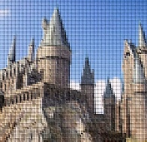

Slide 3
CAN DATA SCIENCE PREDICT THE SUCCESS OF
AMUSEMENT PARK ATTRACTIONS?
The amusement park industry is a large piece of the world economy’s hospitality sector and competition for guests is keen.
The cost of new attractions continues to climb, and industry players must search for better ways to quantify potential guest interest
and increase revenue.
Google Trends may provide new insight to help predict success of theme park attractions and ensure better outcomes.
2

Slide 3
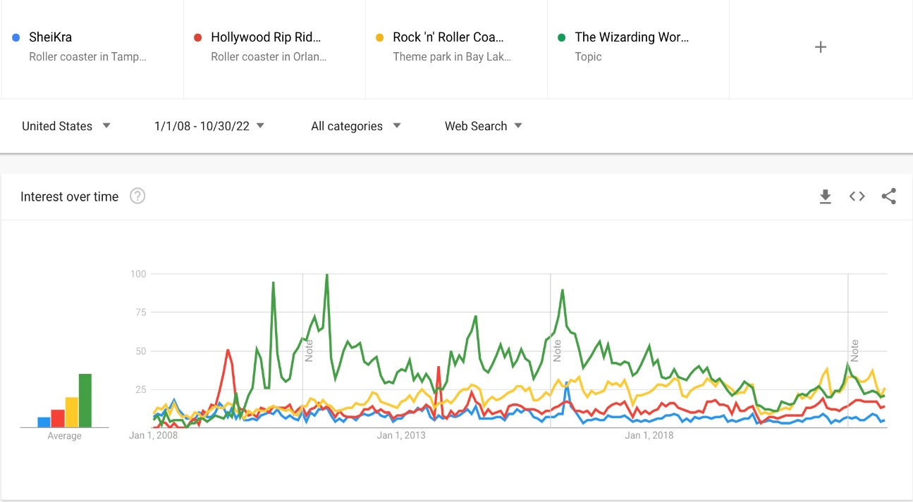
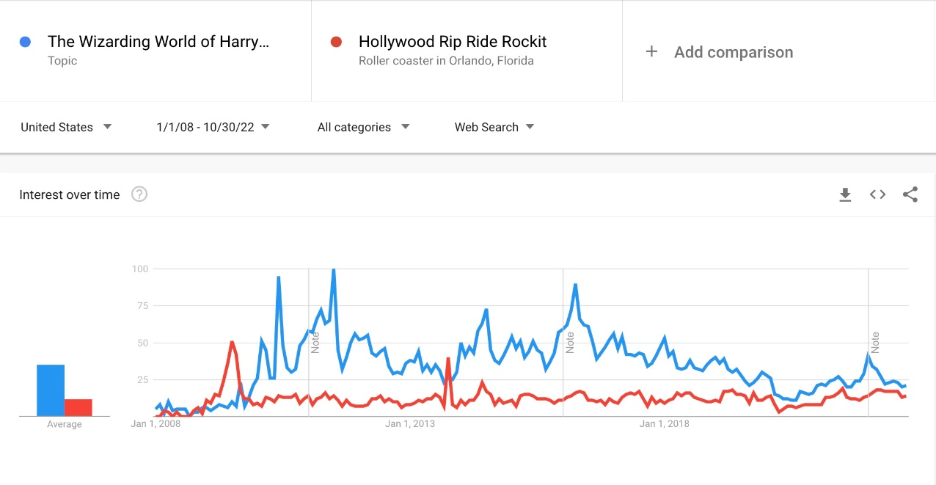
Slide 2
POPULARITY OF THEMED x UNTHEMED ATTRACTIONS
Google Trends Comparison:
Comparison of the popularity of three Florida coasters with the Wizarding World of Harry Potter shows the dominance of themed lands. Not all popularity is positive: The spikes of SheiKra in 2016 arose when the ride was stuck 200 ft in the air. Likewise, Rockit’s spike in 2013 came from a similar event.
In Universal, a comparison of two attractions (one, a roller coaster, and the other, a themed land) shows the dramatic dominance of themed lands over thrill coasters.
3

Slide 4
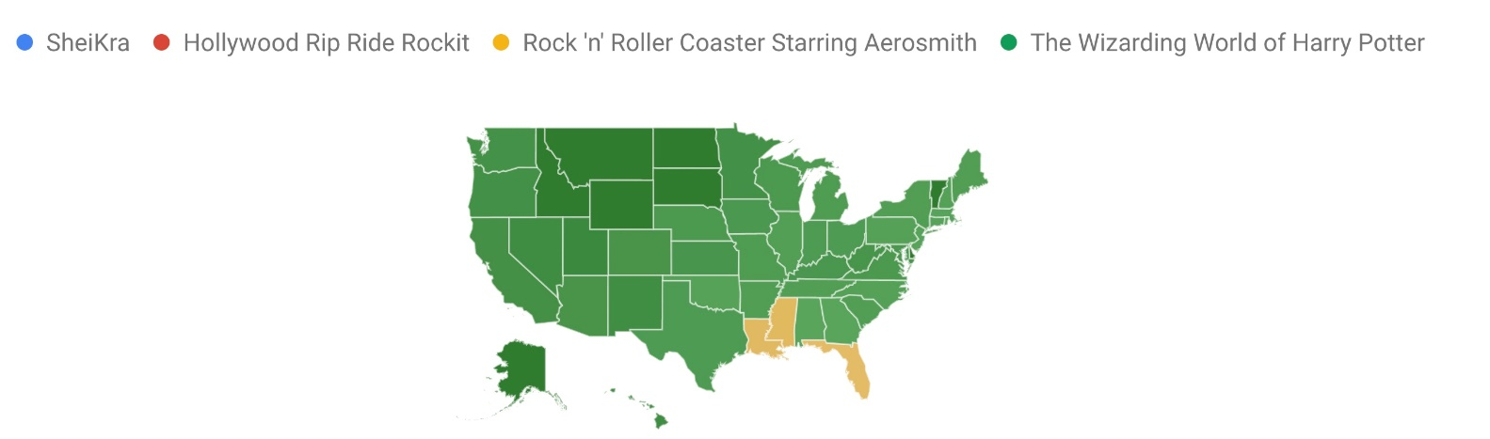
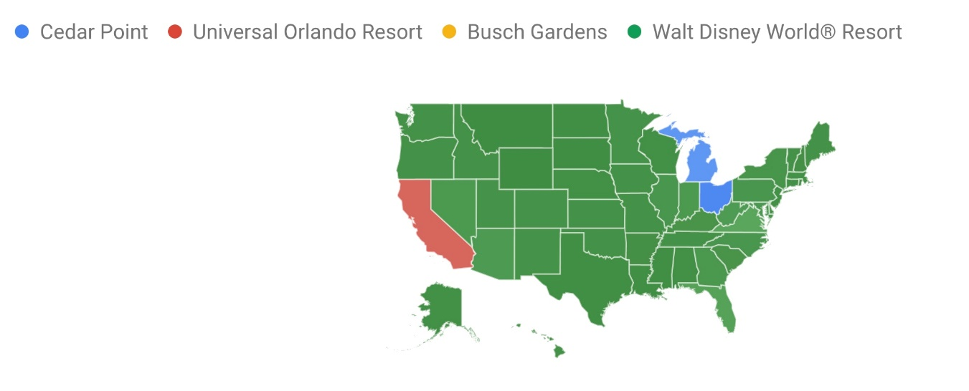
Slide 2
DOMESTIC POPULARITY OF ATTRACTIONS AND PARKS
Google Trends compares online popularity of three Florida coasters with a themed land, revealing the dominance of the Wizarding World.
Note that only Michigan and Ohio have Cedar Point, a local coaster park, is more popular than Walt Disney World, which is a theme park.
4

Slide 5
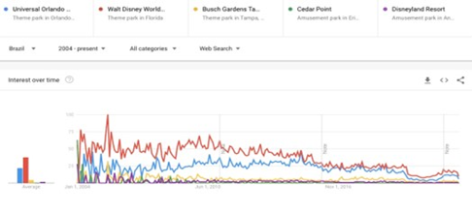
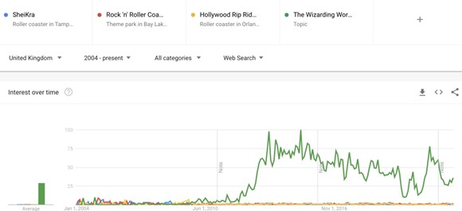
Slide 2
INTERNATIONAL POPULARITY
Google Trends reveals the same tendencies in international interest. In Brazil, Universal Orlando is highly competitive with Disney, while the other parks are significantly less searched.
Also, in the “Related Queries” section for Universal, the 6th ranking is
“Harry Potter.” Moreover, the popularity of the Wizarding World absolutely crushes three other Florida landmark rides in the UK.
5

Slide 6

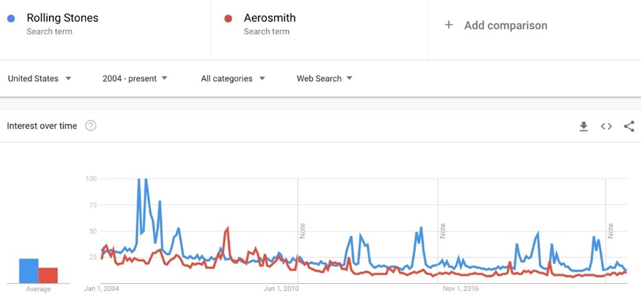
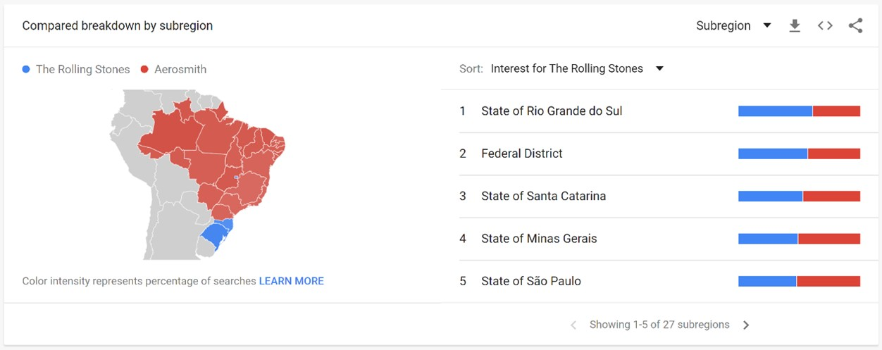

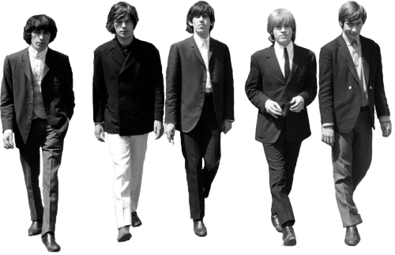
Slide 2
PENNYWISE OR POUND FOOLISH?
Disney opted to save a purported $10M in the 1990s by choosing Aerosmith over the Rolling Stones for their Rock ‘n’ Rollercoaster theme, despite the difference in popularity.
5

Slide 7
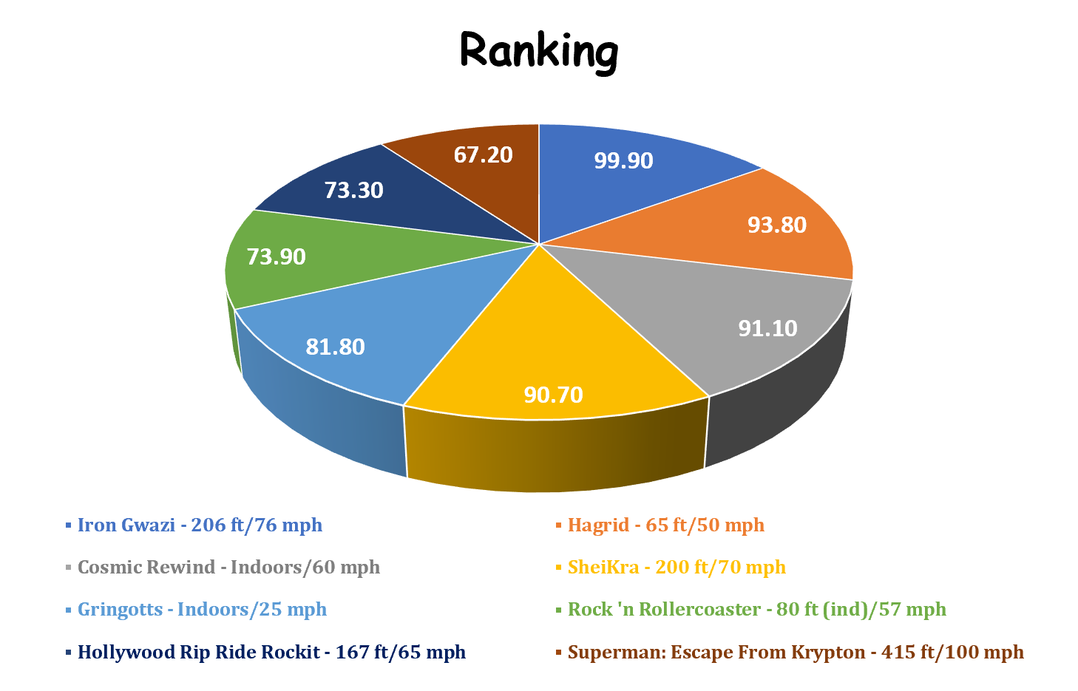
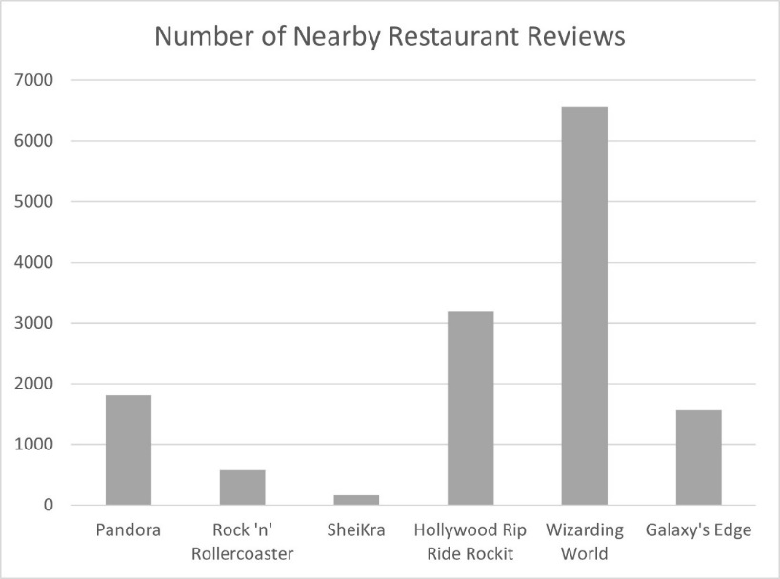
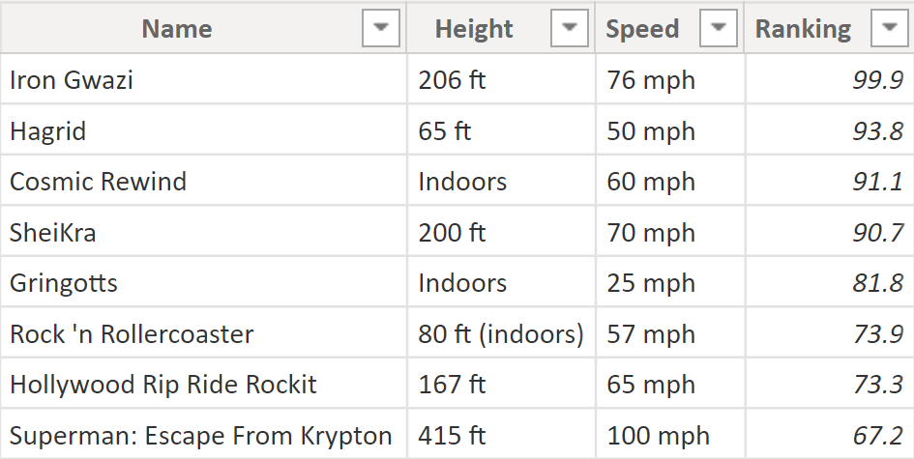



Slide 4
BACKUP: TRADITIONAL DATA
Ride rankings from CaptainCoaster show that even modest coasters that are highly themed can successfully compete with wild thrill rides.
Restaurant reviews from TripAdvisor and Yelp corroborate the Google Trends data. There are more restaurant reviews in themed lands than in the vicinity of non-themed attractions.
6

Slide 8

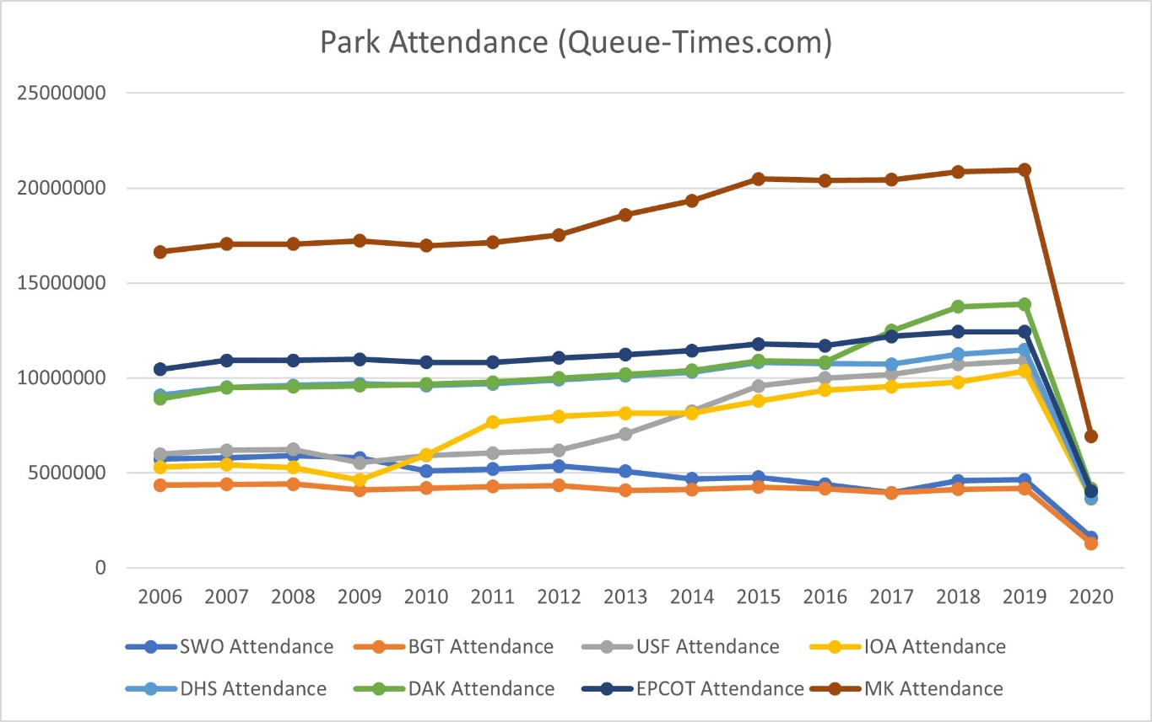
Slide 10
ATTENDANCE = REVENUE
The dramatic rise of attendance in Islands of Adventure and Universal Studios Florida compared to their competition follows the introduction of the themed land, the Wizarding World of Harry Potter Hogsmeade in 2010 and Diagon Alley in 2014.
7

Slide 9
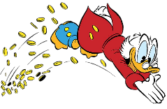
Slide 3
WHAT DATA SCIENCE TELLS US
Market Globally
Execution Matters
Theme Lands > Thrill Rides
8

Slide 10
THANK YOU

